Slide 1

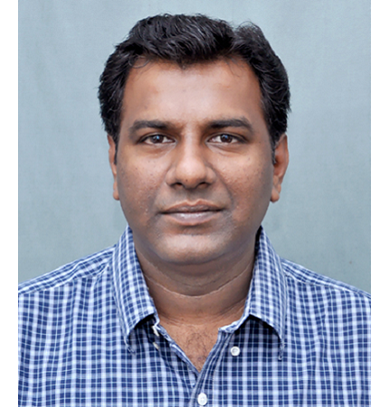
Prof. Dilip Ganguly
Centre for Atmospheric Sciences, IIT Delhi, Hauz Khas, New Delhi 110016
Email: dilipganguly@cas.iitd.ac.in
DECODING THE DRIVERS OF INDIA’S SEASONAL AIR POLLUTION: METEOROLOGY, EMISSIONS, AND CROSS-BORDER TRANSPORT
ABSTRACT
Severe and persistent air pollution episodes across northern India arise from a complex interplay between emissions, meteorology, and cross-border transport. Present work synthesizes results from high-resolution WRF-Chem and WRF–CMAQ model simulations to quantify the contributions of local, regional, and transboundary sources to fine-particulate (PM2.5) pollution across the Delhi-NCR region and the Indo-Gangetic Plain. The analyses reveal that residential fuel combustion remains the largest contributor, accounting for 40–55% of PM2.5 concentrations, while episodic crop-residue burning in Punjab and Haryana causes short-lived spikes of 30–50%. Organic aerosols dominate the chemical composition, followed by black carbon and secondary inorganics. Meteorological variability alone modulates PM2.5 by ±25–35 µg m⁻³ through boundary-layer and ventilation effects, while cross-border inflows add ±8–11 µg m⁻³. Emission-control experiments show that reducing residential, transport, and industrial emissions by half, along with eliminating crop burning, can lower winter PM2.5 levels by up to 50% and significantly increase the number of satisfactory air-quality days. However, local mitigation in Delhi alone yields limited improvement because polluted inflows from adjacent states persist under prevailing wind conditions. These results demonstrate that India’s air pollution challenge is both meteorology- and transport-driven, highlighting the need for an integrated airshed-based management strategy that coordinates emission control, meteorological forecasting, and regional cooperation across the Indo-Gangetic Plain.
ABOUT THE SPEAKER
Dr. Dilip Ganguly is a Professor at the Centre for Atmospheric Sciences, IIT Delhi. He has over 25 years of research experience investigating the
linkages between air pollution and climate change through observations and chemistry–climate modeling. His expertise lies in simulating the
life cycle of aerosols in global and regional chemistry–climate models. He extensively uses remote sensing data from satellites and in-situ observations across the world to validate model results.

