Slide 1

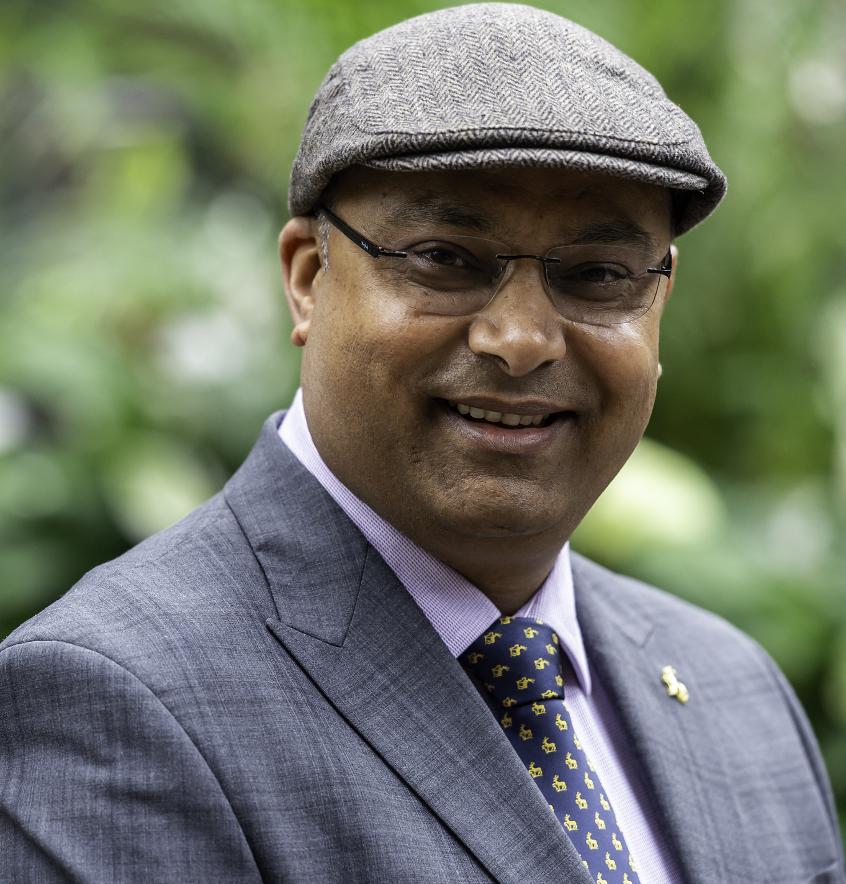


Professor Prashant Kumar
Global Centre for Clean Air Research (GCARE) & Institute for Sustainability, University of Surrey, Guildford, Surrey, United Kingdom
P.Kumar@surrey.ac.uk
YOUR
PHOTOGRAPH
Inequitable Air: Prescribing Nature-Based Solutions for Cleaner Urban Environments
ABSTRACT
The adage that “we all breathe the same air” is a precarious misconception. Urban populations face stark inequalities in air pollution exposure, a crisis intensified by climate change. For two decades, the University of Surrey’s Global Centre for Clean Air Research (GCARE) has challenged this paradigm, revealing how vulnerable groups from children to the elderly face disproportionate risks across indoor and outdoor micro-environments. This presentation distils GCARE’s pioneering journey in prescribing urban greening, or nature-based solutions (NBS), for cleaner air. It chronicles our evolution from foundational research on roadside green infrastructure to community-empowering initiatives like GP4Streets, which provides tailored ‘greening prescriptions’, and global knowledge-exchange via the RECLAIM Network Plus. Furthermore, we address the critical frontier of indoor air quality through the GREENIN and HealthySailing projects. By integrating advanced monitoring, citizen science, and co-design – exemplified by our Guildford Living Lab – GCARE translates evidence into practical tools, policy briefs, and passive control strategies to ensure the right to clean air is a universal reality.
ABOUT THE SPEAKER
Prashant Kumar is Chair in Air Quality and Health, the founding Director of the Global Centre for Clean Air Research (GCARE), the founding Co-Director of the Institute for Sustainability, and the founder of Guilford Living Lab, Trustee of Zero Carbon Guildford, Adjunct Professor at Trinity College Dublin, Guest Professor at Southeast University, and Distinguished Guest Professor at Chongqing University. He obtained his PhD (Engineering) from the University of Cambridge (UK) after winning a Cambridge-Nehru Scholarship and Overseas Research Scholarship award. He earned his Master's Degree in Environmental Engineering & Management from the Indian Institute of Technology, Delhi, where he won the ‘Outstanding Postgraduate Student Award’ for his exemplary performance (CGPA 9.8/10) .
Winner of the 2023 “Haagen-Smit Clean Air Award,” regarded as the "Nobel Prize in Clean Air Achievements“, he was recognised as a top 1% Highly Cited Researcher by Clarivate in 2022, 2023 and 2024. He received the University of Surrey’s Vice-Chancellor Award for Researcher of the Year in 2017, and his paper on green infrastructure won the “2023 Haagen-Smit Prize for Best Paper” from Elsevier. With over 450 journal articles published in prestigious journals like Science, Nature Cities, and Chemical Society Reviews, he has garnered ~33,000 citations (h-index, 88, i10-index, 400). He has successfully secured over £25M in individual research funding from UKRI, including roles as a lead on the £1.45M RECLAIM Network Plus, £2M GP4Streets, and £0.6M GREENIN projects, as well as support from industry and international organisations. His research frequently appears in prominent media outlets, including the BBC and The Times. Visit www.surrey.ac.uk/gcare for more information.

